Slide 1

Midterm Sharing
Intern: Matt

Slide 2
Table of Content
3 months of intern
What is NER ?
導入AI-越南法院判例
MLOps-NER-Web
Future

Slide 3
3 months of intern
1-3 week
Tutorial & GCP
4-7 week
NER model
8-11 week
NER Web

Slide 4
NER (Named Entity Recognition)
Named entity recognition (NER) is a natural language processing (NLP) method that extracts information from text. NER involves detecting and categorizing important information in text known as named entities. Named entities refer to the key subjects of a piece of text, such as names, locations, companies, events and products.
命名實體識別（NER）是一種從文本中提取資訊的自然語言處理（NLP）方法。 NER 涉及對文本中稱為命名實體的重要資訊進行檢測和分類。 命名實體是指一段文字的關鍵主題，例如名稱、位置、公司、事件和產品。
Notes:
https://www.techtarget.com/whatis/definition/named-entity-recognition-NER

Slide 5
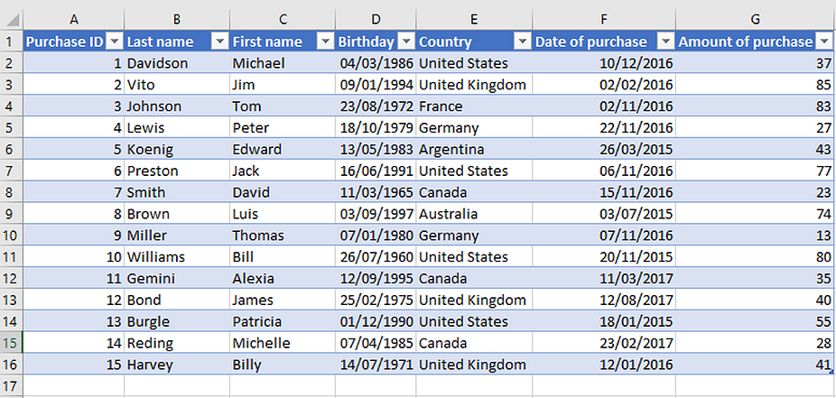
使用場景之一
Davidson Michael, born on April 3rd, 1986, from the United States, made a purchase on December 10th, 2016, with an amount of $37
Unstructured Data 非結構化資料 | Structured Data 結構化資料
Business Documents | Excel Files
Emails | SQL databases
Social Media | Dates and time
Images, Audio and Video | Customer names and contact info
Notes:
https://www.altexsoft.com/blog/structured-unstructured-data/

Slide 6

在銀行業務中導入AI
偵審流程
+
金融罪犯比對系統
偵審流程
通過
拒絕

Slide 7
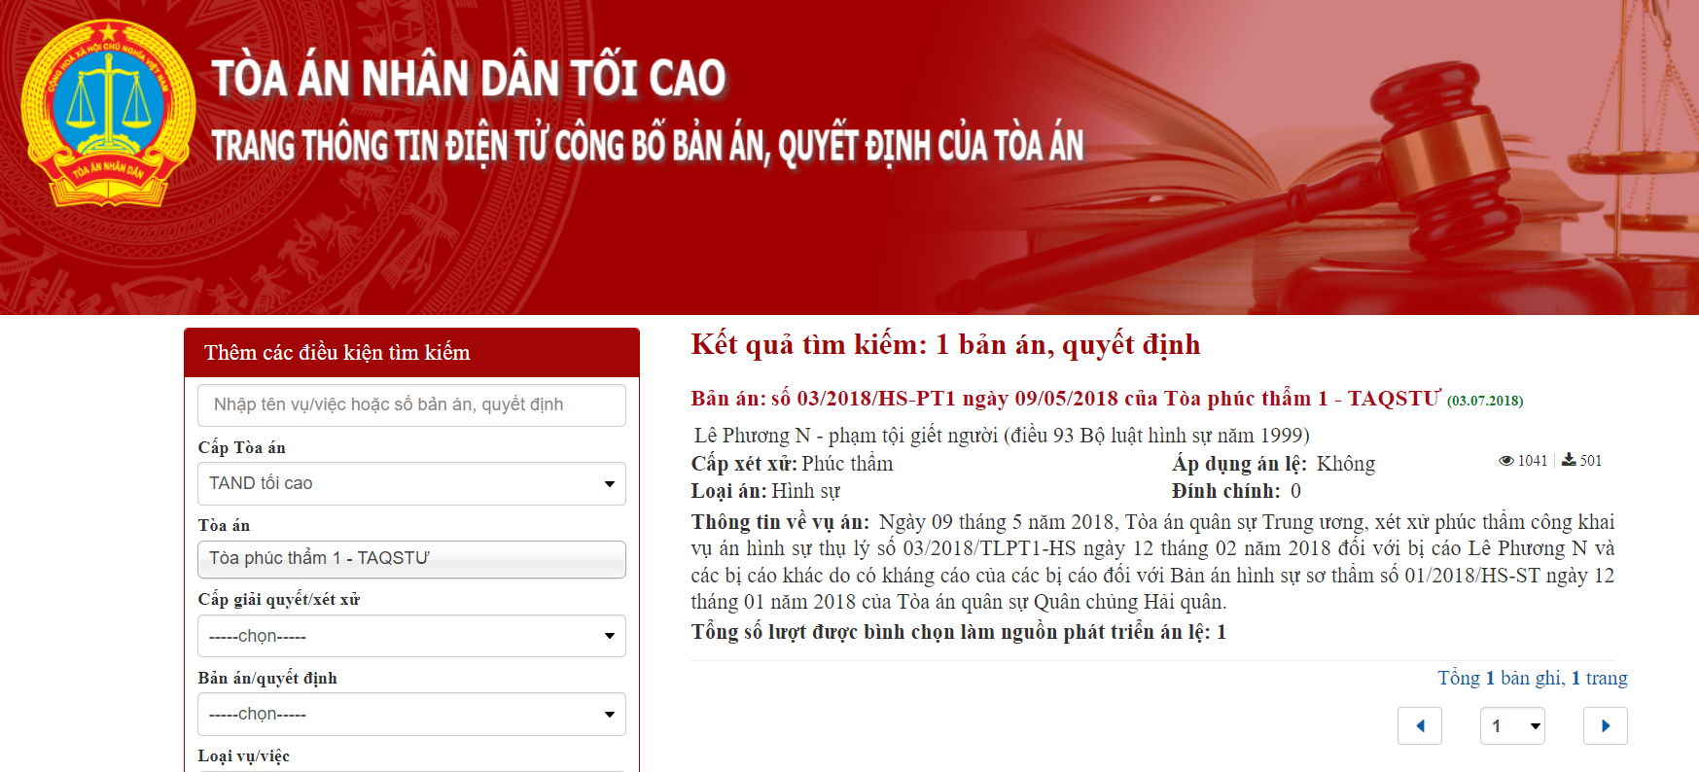
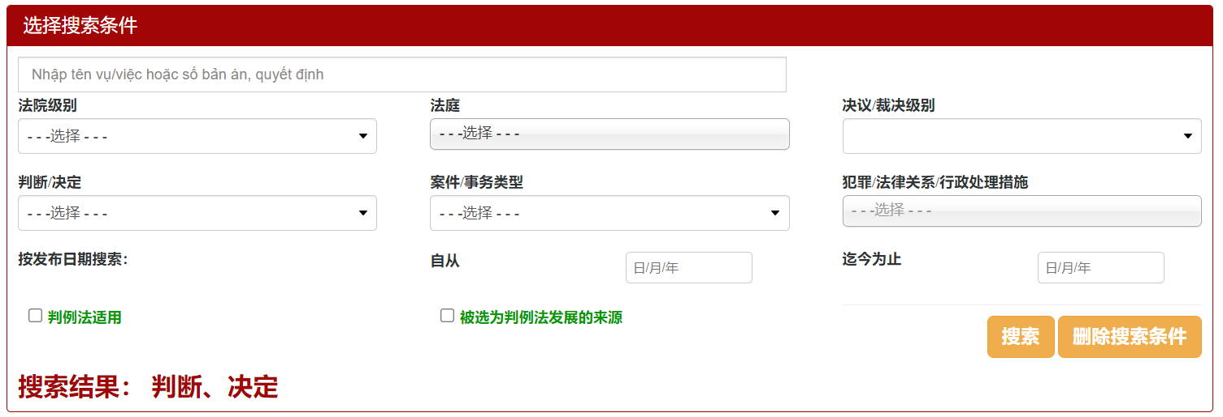
越南法院判例

Slide 8
越南法院判例結合NER
姓名：Nguyễn Văn C
Họ và tên: Nguyễn Văn C – Giới tính: Nam Sinh ngày: 25/01/1994 Dân tộc: Kinh; Tôn giáo: Thiên chúa giáo; Trình độ văn hóa: 9/12 Nơi cư trú: thôn 12, xã T, huyện A, tỉnh N Nghề nghiệp: Lao động tự do Tiền án, tiền sự: Không Con ông: Nguyễn Văn Trung; con bà: Nguyễn Thị Hà. Có mặt tại phiên họp
性別：男
生日：25/01/1994
職業：自由工作者

Slide 9



使用場景
申請人
對比
資料庫
結果

Slide 10
所以，這就是可以使用（部署）的嗎？
現況
已清理資料約36,000筆法院判例資料
完整資料約1,000,000筆法院判例資料

Slide 11
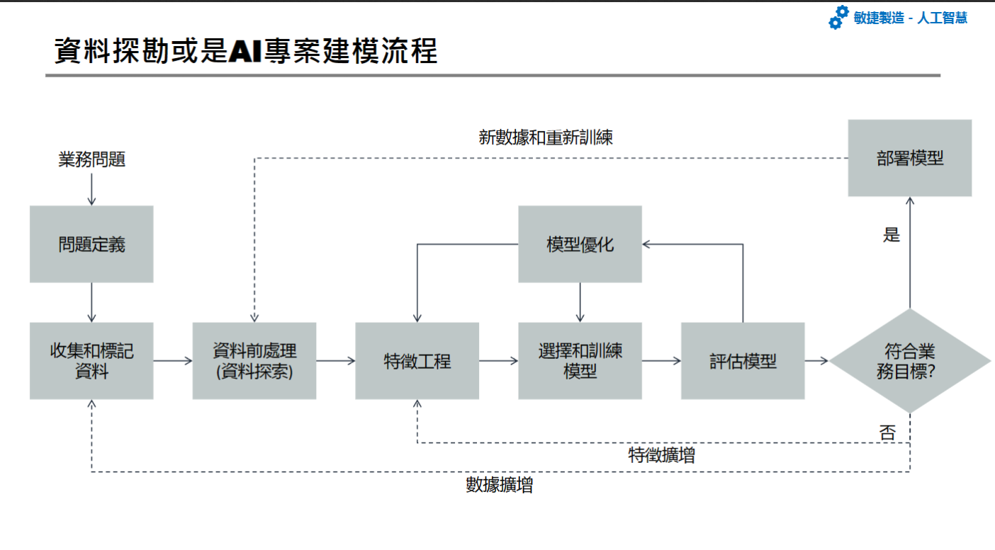

Slide 12
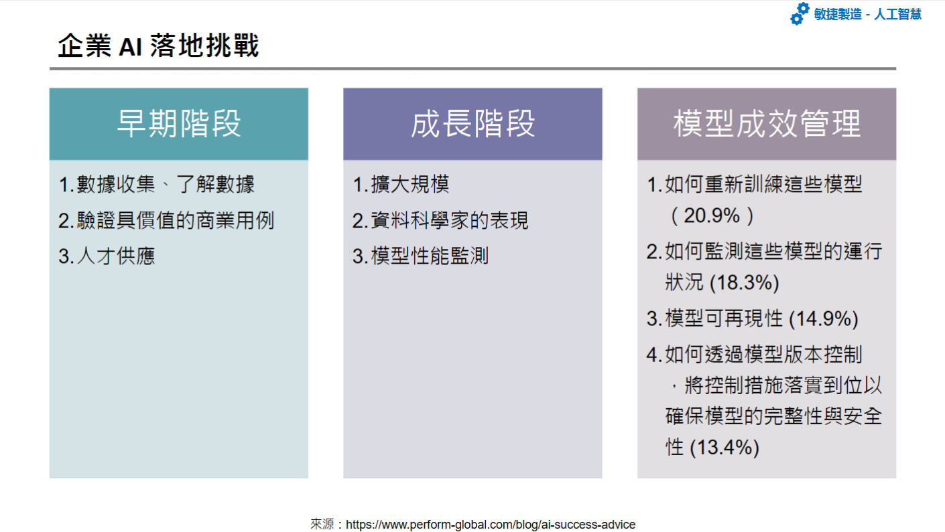

Slide 13
MLOps
簡化和自動化機器學習模型開發和部署的過程。
結合DevOps的元素，如持續集成和持續交付（CI/CD），敏捷MLOps在機器學習模型的生命週期中高效、可靠地部署ML模型

Slide 14
MLOps 原則
自動化和集成
持續整合和持續部署（CI/CD）
版本控制
監控和運維
再訓練和模型更新
協作和溝通

Slide 15
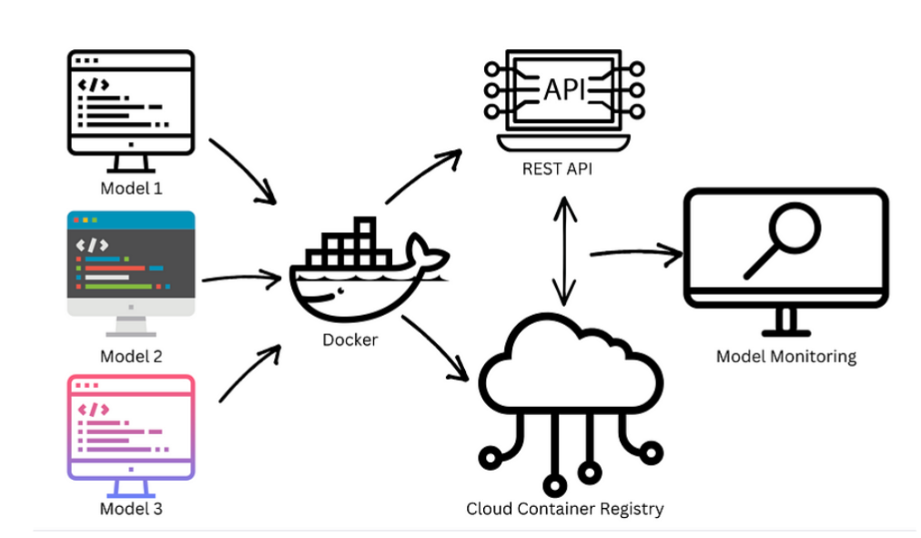
Notes:
https://towardsdatascience.com/model-rollbacks-through-versioning-7cdca954e1cc

Slide 16

NER Web
NER Web是專為越南法院判例資料集量身定制的命名實體識別(NER)。 通過我們直觀的界面輸入文本數據即可可提取命名實體，如姓名和出生日期。
http://34.125.210.223:5000/

Slide 17









Server
FrontEnd
BackEnd
Infrastructure
Services

Slide 18
功能介紹
NER WEB
Data
Train
Inference
檢視/查看資料集
擴增/新增資料集(開發中)
選擇資料、大小
訓練
選擇模型
測試結果

Slide 19
網頁展示
*注意*
dataset 請選擇 [criminal_data_inorder]
可選擇約10筆就能大致瞭解資料樣式

Slide 20
POS Tagging
Chunking
NER
Label | Description
Np | Proper noun
C | Subordinating conjunction
M | Numeral (1/one)
V | Verb
CH | Punctuation mark
R | Adverb
Nc | Classifier
N | Common noun
E | Preposition
A | Adjective
P | Pronoun
R | Adverb
Label | Description
O | Outside of chunk (other)
B-VP | Beginning of a verb phrase
B-AP | Beginning of adj phrase
I-NP | Inside of a noun phrase
B-PP | Beginning of a prepositional phrase
B-NP | Beginning of a noun phrase
Label | Description
O | Outside of NE
B-LOC | Beginning of location NE
I-LOC | Inside of location NE
B-MISC | Beginning miscellaneous NE
I-MISC | Inside of miscellaneous NE
B-PER | Beginning of a person NE

Slide 21
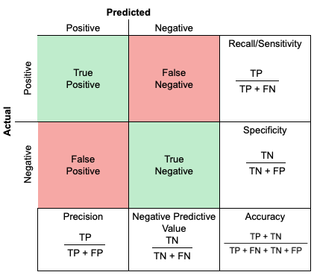
Model Training
*注意*
dataset 請選擇 [criminal_data_inorder]

Slide 22
Inference
Add two labels:
[N: Name, M: Birthdate/Date]
Examples:
1. Trần Văn Q Sinh ngày 23 tháng 4 năm 1993 Nghề nghiệp: Lao động tự do Nơi ĐKHKTT và chỗ ở: Tổ Phố M, phường Ngọc S, quận K, TP. H; Con ông Trần Văn Nh Con bà Phú Thị L
2. Nguyễn Văn T, sinh ngày 28/6/1996; nghề nghiệp: Lao động tự do; nơi cư trú: Xóm 9, xã Công Thành, huyện Yên Thành, tỉnh Nghệ An; con ông Nguyễn Văn Viện và bà Nguyễn Thị Trang.

Slide 23
Future Work
1. 擴增原始資料量
模型迭代/更新
擴增罪犯資料庫名單
2. 快速比對方法
[申請人與資料庫]

Slide 24
Q&A

Slide 25
Thanks for listening

Slide 26
Model Evaluation
Overall Accuracy: 0.9737038192704791
Overall Precision: 0.9734881814197965
Overall Recall: 0.9737038192704791
Overall F1-score: 0.9733168344615485
Label | Accuracy | Precision | Recall | F1-score
M | 0.927164 | 1 | 0.927164 | 0.962206
N | 0.644908 | 1 | 0.644908 | 0.784126
B-PER | 0.901387 | 1 | 0.901387 | 0.948136
I-PER | 0.338070 | 1 | 0.338070 | 0.505310
Other | 0.986772 | 1 | 0.986772 | 0.993342

